Slide 1
The text classification on news in Chinese
1530005003 陈彤
1530005037 谢伟雁
1530005049 张见一
1530005050 张可

Slide 2
CONTENTS
Introduction
1
2
Data Description
Data Modeling
3
4
Result
Conclusion
5

Slide 3
1
Introduction

Slide 4

1
Introduction
RESEARCH BACKGROUNDS
What is Text Classification
Text classification is the process of assigning tags or categories to text according to its content.
It’s one of the fundamental tasks in Natural Language Processing (NLP) with broad applications such as sentiment analysis, topic labeling, spam detection, and intent detection.
Notes:
背景这些就水一水读ppt过就行

Slide 5

1
Introduction
Text Classification
Text can be an extremely rich source of information, but extracting insights from it can be hard and time-consuming due to its unstructured nature. Businesses are turning to text classification for structuring text in a fast and cost-efficient way to enhance decision-making and automate processes.
Notes:
背景这些就水一水读ppt过就行

Slide 6

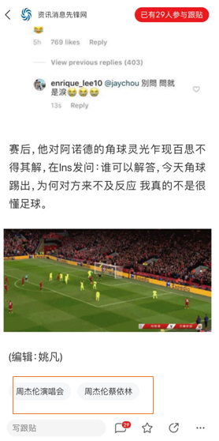



1
Introduction
Motivation
Notes:
背景这些就水一水读ppt过就行

Slide 7
2
Data description

Slide 8
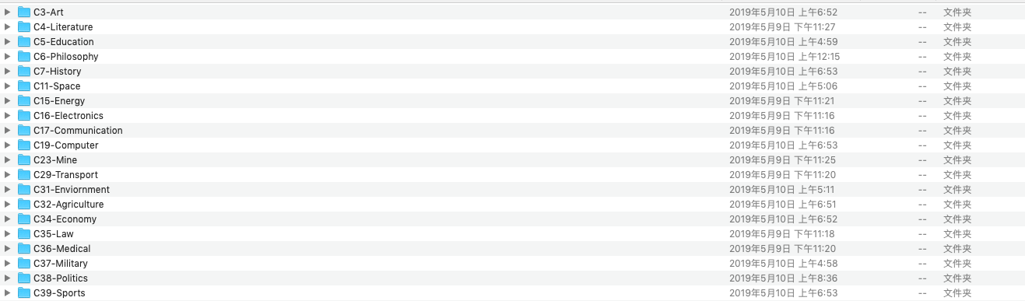
2
Data description
Classification
data | filename | quantity
Test data | test_corpus.rar | 9833
Training data | train_corpus.rar | 9804
Category | 20

Slide 9
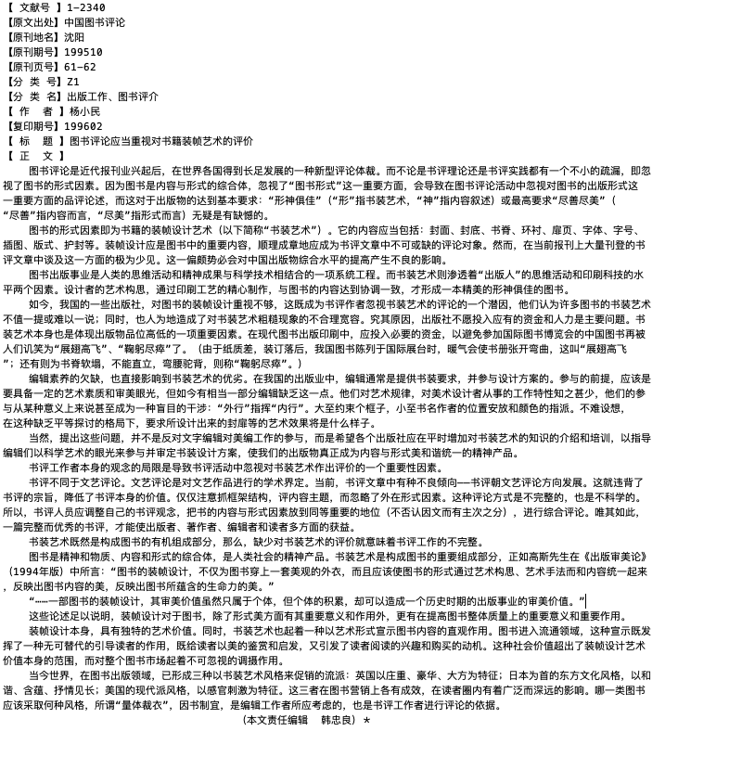
2
Data description
The text is stored as .txt file
a sample text:

Slide 10
3
Data Modeling

Slide 11
3
Data Modeling
Challenge:
How to transform this problem into a mathematical model
How to transform each text into a numerical representation
No matter how powerful an algorithm is, it is only used to solve a mathematical problem.

Slide 12
Step 1:Divide the Sentence
3
Data Modeling
记者从广东省高级人民法院获悉，经诉讼调解，华为技术有限公司与三星(中国)投资有限公司在涉及标准必要专利的侵权纠纷系列案中达成全球和解，就全球范围内的标准必要专利交叉许可问题达成框架性的《专利许可协议》
Divide the whole sentences into many single words
Jieba Analysis
Here are some examples using Jieba to do the division
seg_list = jieba.cut("北京师范大学香港浸会大学联合国际学院", cut_all=False)
print("Default Mode: " + "/ ".join(seg_list))
Default Mode: 北京师范大学/ 香港浸会大学/ 联合/ 国际/ 学院
Default Mode: 记者/ 从/ 广东省高级人民法院/ 获悉/ ，/ 经/ 诉讼/ 调解/ ，/ 华为技术有限公司/ 与/ 三星/ (/ 中国/ )/ 投资/ 有限公司/ 在/ 涉及/ 标准/ 必要/ 专利/ 的/ 侵权/ 纠纷/ 系列/ 案中/ 达成/ 全球/ 和解/ ，/ 就/ 全球/ 范围/ 内/ 的/ 标准/ 必要/ 专利/ 交叉/ 许可/ 问题/ 达成/ 框架/ 性/ 的/ 《/ 专利/ 许可/ 协议/ 》

Slide 13
Step 1:
3
Data Modeling
Here we write the code to read every .txt file in training corpus and testing corpus and divide them into single words.
We store the results after finishing the division into new folders: train_corpus_seg and test_corpus_seg
Remark: before running the Jieba, we write code to delete the whitespace, line feed in original .txt file

Slide 14
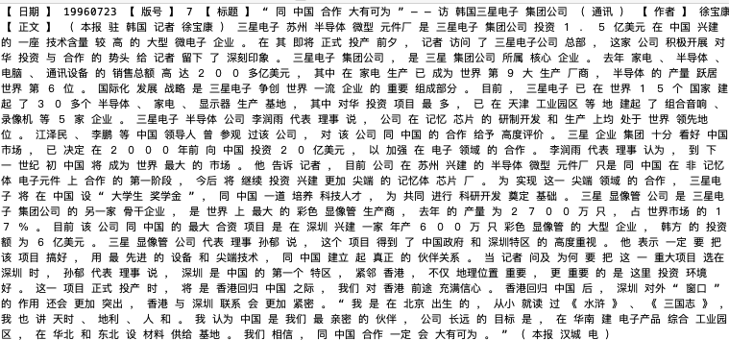
Here is an example of .txt after doing the division:
3
Data Modeling

Slide 15
Step 2:feature extraction
3
Data Modeling
Use mathematical form to model the features of these texts
We consider that the frequency of some specified words in news is highly related to the categories of this news
Here we create the word vectors to represent the feature of each text

Slide 16
Step 2:
3
Data Modeling
Find out the words that are important to some specified category.
Common way is to use the frequency of words to represent the importance, but such way is not reasonable in some way.
Ignore the words that is common in Chinese writing, such kind of word could be used often in any category.
Like “你”，“我”，“他”
Take TF-IDF (term frequency–inverse document frequency) Strategy

Slide 17
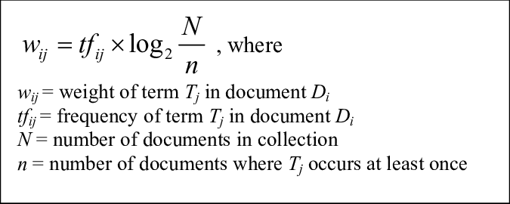
TF-IDF
3
Data Modeling
Obtain TF-IDF Matrix
TF-IDF Matrix – a two-dimensional matrix
tdm[i][j] represents
The TF-IDF value of j_{th} word in i_{th} category

Slide 18
4
Result

Slide 19
4
Result
Comparison of various classification methods
order | classifier | f1 | precision | recall
1 | Random Forest | 0.86 | 0.86 | 0.87
2 | Logistic Regression | 0.85 | 0.83 | 0.88
3 | Naive Bayes | 0.78 | 0.79 | 0.76
4 | KNN | 0.75 | 0.76 | 0.74
5 | SVM | 0.71 | 0.69 | 0.72
6 | Decision Tree | 0.64 | 0.67 | 0.61
F1 = 2*(Precision*Recall)/(Precision+Recall)
RF, LR and Naïve Bayes are the best 3 methods by weighted F1

Slide 20
4
Result
Tuning parameter of KNN

Slide 21
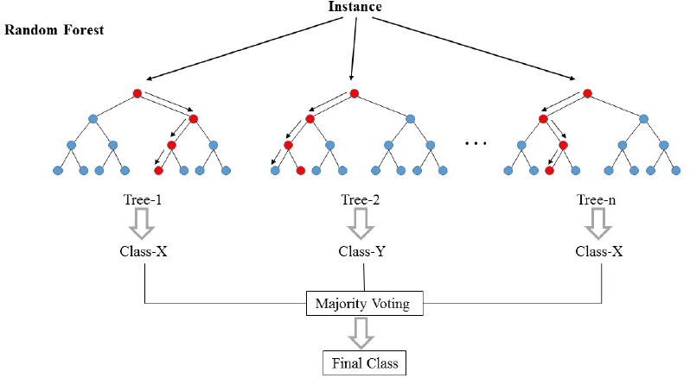
4
Result
Random Forest
Ensemble learning method by bagging method
which have outstanding performance for big data
Notes:
Accuracy.

Slide 22
4
Result
Tuning parameter of Random Forest

Slide 23
4
Result
Comparison of various classification methods
ROC AUC
Random Forest is the best method by both F1 and ROC

Slide 24
4
Result
Evaluation of Random Forest
635
35
classifier | f1 | precision | recall
C3-Art | 0.94 | 0.94 | 0.95
C4-Literature | 0.93 | 0.90 | 0.95
weighted | 0.94 | 0.93 | 0.95
17
324

Slide 25
5
Conclusion

Slide 26
Different algorithms adapt to different mission scenes and data, we can use effective evaluation criteria like AUC to compare them and use grid-search parameter with 10-fold to tune parameter and get a good model

Slide 27
Thanks

